Slide 1
How to create an Automation framework from scratch
Using Selenium Webdriver

Slide 2
Add Project Folders
In Solution Explorer, right click on the project name
Click on Add->New Folder
Add new folders for:
Features,
Pages,
Steps and
Utilities
Also create a Shared subfolder in Steps. Your Hooks file will go here later.

Slide 3
Install the following via Manage NuGet Packages
DotNetSeleniumExtras.WaitHelpers * (It would be useful to store a copy of this offline)
DotNetSeleniumExtras.PageObjects * (only if using Page Factory)
Selenium.Support
Selenium.WebDriver
Selenium.WebDriver.ChromeDriver
SpecFlow
SpecFlow.MsTest
MSTest.TestAdaptor
MSTest.TestFramework (these last 2 should come already installed)
* - Be careful using these as they are likely to be deprecated.

Slide 4
Add Driver class to Utilities folder.
NOTE: Normally make the Driver class Public Static. All driver methods are also Public Static.
In the using section add:
using System;
using OpenQA.Selenium;
using OpenQA.Selenium.Chrome;
using OpenQA.Selenium.IE;
using OpenQA.Selenium.Support.UI;
At the top of the Driver class add:
public static IWebDriver driver;
public static WebDriverWait wait;
//These values come from .runsettings file, set via WebHooks (explained later)
public static string RootURL;

Slide 5
Driver Class - Include the following methods (for example):
OpenBrowser(string selectedBrowser) –
This method needs to be included as a minimum. It should also maximise the window and create an instance of the WebDriverWait .
We will see alternative versions of this method later, when we come to Configuration files.

Slide 6
Openbrowser
public static void OpenBrowser(string selectedBrowser)
{
switch (selectedBrowser.ToLower())
{
case "chrome":
driver = new ChromeDriver();
driver.Manage().Window.Maximize();
break;
case "ie":
driver = new InternetExplorerDriver();
driver.Manage().Window.Maximize();
break;
default:
Debug.Print("unknown browser selected");
break;
}
wait = new WebDriverWait(driver, TimeSpan.FromSeconds(5));
}

Slide 7
public static void NavigateTo(string targetURL)
{
driver.Navigate().GoToUrl(targetURL);
}
public static void ShutDown()
{
driver.Quit();
}
Don’t call it Quit() as you could end up calling it in an endless loop if you call Driver.Quit() instead of driver.Quit() !
A note about Static Classes and Methods
A static method does NOT need and instance of its class to call it.
So call like this
Driver.ShutDown();
Not:
Driver myDriver = new Driver();
myDriver.ShutDown();

Slide 8
Configuration Files
App.config - a file per environment
test.runsettings (this file can be called anything as long the file type is .runsettings.)
- the CI tool will overwrite the settings in this file depending on the environment that it is running in

Slide 9
App.config file:
Add the following within the <configuration> </configuration> section:
<configSections>
<section name="specFlow" type="TechTalk.SpecFlow.Configuration.ConfigurationSectionHandler, TechTalk.SpecFlow" />
</configSections>
<specFlow>
<!-- For additional details on SpecFlow configuration options see http://go.specflow.org/doc-config -->
<!-- For additional details on SpecFlow configuration options see http://go.specflow.org/doc-config -->
<unitTestProvider name="MsTest" /></specFlow>

Slide 10
At the bottom of the <configuration> section, enter the following:
<appSettings>
<add key="DefaultTimeoutSeconds" value="10"/>
<add key="Browser" value="Chrome"/>
<add key="BaseURL" value ="http://porapp01qa/"/>
</appSettings>
Enter more key value pairs inside appSettings section as required

Slide 11
Configuration Manager
In order to access App.config, you will need to use Configuration Manager class.
Right-click on the References / Dependencies
Choose Add Reference
Find and add System.Configuration. (in Assemblies)

Slide 12
Now, to be able to get the values of the DefaultTimeoutSeconds key and you added earlier, write these methods in your Driver class:
public static string GetValueFromConfigKey(string key)
{
return ConfigurationManager.AppSettings[key];
}
public static int GetTimeoutSeconds()
{
var time = GetValueFromConfigKey("DefaultTimeoutSeconds");
return int.Parse(time);
}
public static string GetBrowser()
{
return GetValueFromConfigKey("Browser");
}

Slide 13
Now you can write a new version of OpenBrowser() that gets the browser from App.config
public static void OpenBrowser()
{
switch (GetBrowser().ToLower())
{
case "chrome":
driver = new ChromeDriver();
driver.Manage().Window.Maximize();
break;
case "ie":
driver = new InternetExplorerDriver();
driver.Manage().Window.Maximize();
break;
default:
Debug.Print(("unknown browser selected"));
break;
}
wait = new WebDriverWait(driver, TimeSpan.FromSeconds(GetTimeoutSeconds()));
}
Alternatively, you could just use the previous version and pass in GetBrowser() as the parameter.

Slide 14
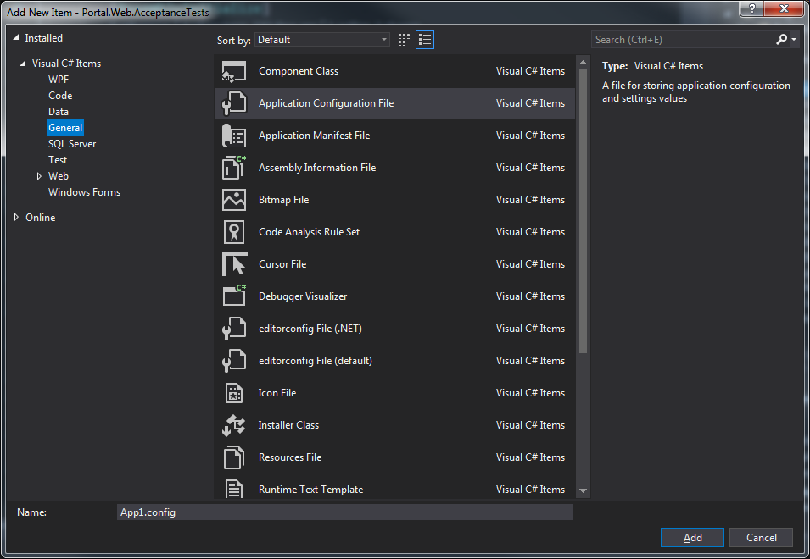
testSettings.runsettings file
In Solution Explorer, at the project level, add a new item.
From LHS panel select General then select an Application Configuration File.
Rename the file so that it has an extension of .runsettings

Slide 15
Change the <configuration> section into a <RunSettings> section
Within this section, add a <TestRunParameters> section
With this section add your various parameters as name value pairs.
E.G.
<?xml version="1.0" encoding="utf-8" ?>
<RunSettings>
<TestRunParameters>
<Parameter name="EnvironmentKey" value="POR QA 01" />
<Parameter name="Browser" value=“Chrome" />
<Parameter name="WebRoot" value="http://porapp01qa/" />
<Parameter name="ApiRoot" value="http://porapp01qa:81/api/" />
<Parameter name="EnableChrome" value="true" />
<Parameter name="EnableIe" value="false" />
</TestRunParameters>
</RunSettings>

Slide 16
RunSettings Class
This is a wrapper class to take care of the interaction with the .runsettings file.

Slide 17
Add code similar to this example:
using System;
using Microsoft.VisualStudio.TestTools.UnitTesting;
namespace BasicFrameworkOne
{
[TestClass]
public class RunSettings
{
//The TestContext variables here are only relevant when run on server.
//context is set by the framework itself. It is static so _testContext needs to be static too. _testContext is passed to the //non-static TestContext that cannot use static variables.
//(Can't pass directly from context to TestContext it seems.)
[AssemblyInitialize]
public static void AssemblyInit(TestContext context)
{
_testContext = context;
}
private static TestContext _testContext;
public TestContext TestContext => _testContext;

Slide 18
//The TestContext.Propeties are set by TFS if tests run remotely on server.
//If run locally, they will be null and the default value will be taken //instead.
public string Browser => (TestContext.Properties["Browser"] ?? "Chrome").ToString();
public string EnvironmentKey => (TestContext.Properties["EnvironmentKey"] ?? "POR QA 01").ToString();
public string WebRoot => (TestContext.Properties["WebRoot"] ?? "http://porapp01qa/").ToString();
public string ApiRoot => (TestContext.Properties["ApiRoot"] ?? "http://porapp01qa:81/api/").ToString();
public bool EnableChrome => Convert.ToBoolean(TestContext.Properties["EnableChrome"] ?? "true");
public bool EnableIe => Convert.ToBoolean(TestContext.Properties["EnableIe"] ?? "false");
}
}

Slide 19
Create Hooks
This class should go in Steps->Shared
This will allow you to get such settings as the Browser and Root URL from the.runsettings file.

Slide 20
using BasicFrameworkOne.Utilities; //location of Driver class
using TechTalk.SpecFlow;
namespace Gaz_Practice_2.Steps.Shared
{
[Binding]
public class Hooks
{
//Since RunSettings class is non-static and the Driver class is static,
//we need a static instance of RunSettings to pass details to Driver class
public static RunSettings _runSettings = new RunSettings();
[BeforeScenario()]
public static void StartBrowsers()
{
Driver.RootURl = _runSettings.WebRoot;
Driver.OpenBrowser(_runSettings.Browser);
}
[AfterScenario]
public void ShutDown()
{
Driver.ShutDown();
}
}

Slide 21
Create a Base Page
BasePage is where you put elements and methods that are common to all/most pages. These will be inherited by the pages that extend BasePage
BasePage does not need to include much. Can have such things as GetClickableElement() and ClickOnElement(). You will probably add to this over time as it becomes apparent that certain methods are common enough to be here.

Slide 22
using System;
using OpenQA.Selenium;
using OpenQA.Selenium.Support.UI; //Need this for WebDriverWait
using BasicFrameworkOne.Utilities; //Location of Driver class
//So it knows to take ExpectedConditions from here instead of (deprecated) OpenQA.Selenium
using ExpectedConditions = SeleniumExtras.WaitHelpers.ExpectedConditions;
namespace BasicFrameworkOne.Pages
{
public class BasePage
{
private IWebDriver baseDriver;
private WebDriverWait baseWait;
//Constructor
public BasePage()
{
baseDriver = Driver.driver;
baseWait = Driver.wait;
}

Slide 23
public IWebElement GetClickableElement(By elementLocator)
{
return baseWait.Until(ExpectedConditions.ElementToBeClickable(elementLocator));
}
public void ClickOnElement(By elementLocator)
{
GetClickableElement(elementLocator).Click();
}
public bool IsElementVisible(By elementLocator)
{
try
{
return baseWait.Until(ExpectedConditions.ElementIsVisible(elementLocator)).Displayed;
}
catch (Exception e)
{
return false; //Element not found, so Displayed is false
}
}
}}

Slide 24
Page Objects
You are now ready create your first page object class, e.g. LoginPage.cs
If not using PageFactory (since it is being deprecated)
Just create pages without the PageFactory.InitElements(Driver.driver, theBasepage);
You will need to create locator Bys instead of WebElements
E.G.
private readonly By _firstNameLocator = By.Id("firstName");

Slide 25
If you are inheriting from a BasePage, then it will just use the constructor from the BasePage, so you don’t need a constructor in the page unless you need something extra.
To inherit from BasePage, write the signature like this:
public class LoginPage : BasePage
Since PageFactory is being deprecated, the elements do not get initialised at page construction, so use element locators at the top of the page instead of elements.
E.G.
private readonly By _passwordLocator = By.Id("Password");
These locator variables are of type By and can be passed into methods that accept that type.
If you access any of the methods from the Driver class, then you will need to include the namespace in your using section.
E.G,
using BasicFrameworkOne.Utilities;

Slide 26
using OpenQA.Selenium;
using BasicSeleniumFramework.Utilities;
namespace BasicSeleniumFramework.Pages
{
public class LoginPage : BasePage
{
//Constructor
//It will just use the one from BasePage unless it needs something extra.
//WebElements
private readonly By _emailLocator = By.Id("Email");
private readonly By _passwordLocator = By.Id("Password");
private readonly By _loginButtonLocator = By.Id("Login-Btn");
//Methods
public void GotoLoginPage(string rootURL)
{
Driver.NavigateTo(rootURL);
}

Slide 27
public void EnterEmail(string emailAddress)
{
IWebElement email = GetClickableElement(_emailLocator);
email.SendKeys(emailAddress);
}
public void EnterPassword(string passwordText)
{
IWebElement password = GetClickableElement(_passwordLocator);
password.SendKeys(passwordText);
}
public void ClickLoginButton()
{
ClickOnElement(_loginButtonLocator);
}
}
}

Slide 28
Feature Files
NOTE: To make sure Specflow generates its code-behind-files for feature files, go to App.config and make sure this line is included:
<unitTestProvider name="MsTest" /></specFlow>
Feature files need to have the .feature extension.
Right click on the Features folder and select Add->New Item.
On the panel on the LHS click on Visual C# Items. Specflow Feature File should now be one of the options on RHS. Select this. Give it a name and click on Add.
A feature file with a basic layout will be created. Amend this as required. More importantly, another file has been generated and is just below the feature file in the hierarchy. This is what links the feature file to your step definition files.

Slide 29
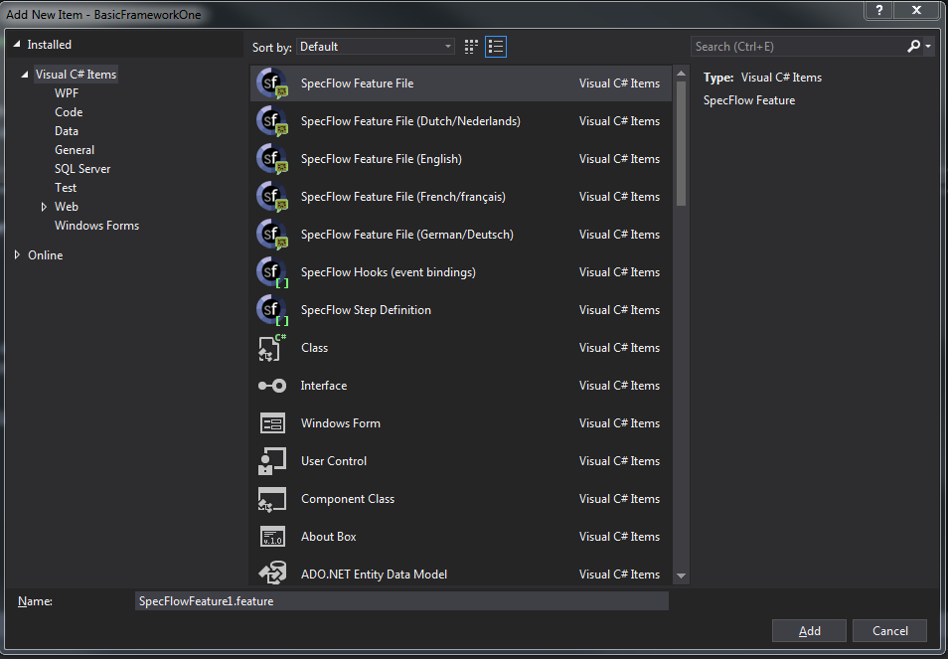
Selecting feature file

Slide 30
Scenario Outline
If you are using input data as part of your feature, you will need to use Scenario Outline: and Examples: followed by a table. The parameters are enclosed in “<>” and must match the names in the table.
Here is an example of such a feature:
Feature: Login
I want to login
@mytag
Scenario Outline: Login
Given I am on the Login Page
When I enter email "<Email>" and password "<Password>"
Then I should be logged in successfully
Examples:
| Email | Password |
| cs@portal.com | Testing321 |

Slide 31
Step Definitions
You are now ready create your first step definition class.
These are the bridges between your test scenarios and the page objects.
You will need to include
using TechTalk.SpecFlow;
using BasicFrameworkOne.Pages; //namespace for your page objects.
You will also need
[Binding]
At the top of namespace, just below the first curly bracket.

Slide 32
Put your page declarations at the top of class, just below the first curly bracket.
E.G.
private readonly LoginPage _theLoginPage;
You will need a constructor for the steps class that includes instantiating all page objects that it will use.
E.G.
public LoginSteps()
{
_theLoginPage = new LoginPage();
}
(Fuller example on later slide)

Slide 33
Creating Steps and linking to Feature file
Now you can start creating steps:
From the Feature File, right click on the first line that you want to create a step for
E.G.
Given I am on the Login Page
And select Go to Definition (F12)
Select Yes to the question about copying the step binding skeleton to the clipboard.
Go back to the step definition file and paste in the skeleton
E.G.
[Given(@"I am on the Login Page")]
public void GivenIAmOnTheLoginPage()
{
ScenarioContext.Current.Pending();
}

Slide 34
You will likely need to include
using TechTalk.SpecFlow;
using BasicFrameworkOne.Pages; //namespace for your page objects.
using BasicFrameworkOne.Utilities; //location of Driver class
Replace the body of the method with the necessary code, this should mostly be calls to the page methods.
E.G.
_theLoginPage.GotoLoginPage();
(Note if you are using RunSettings to hold values such as your RootURL, then this method would likely be called like this:
_theLoginPage.GotoLoginPage(Driver.RootURl);
)
Repeat the above for your other steps.

Slide 35
using TechTalk.SpecFlow;
using BasicFrameworkOne.Pages; //namespace for your page objects.
using BasicFrameworkOne.Utilities; //location of Driver class
using Microsoft.VisualStudio.TestTools.UnitTesting;
namespace BasicFrameworkOne.Steps
{
[Binding]
class LoginSteps
{
private readonly LoginPage _theLoginPage;
private readonly WelcomePage _theWelcomePage;
//Constructor
public LoginSteps()
{
_theLoginPage = new LoginPage();
_theWelcomePage = new WelcomePage();
}
[Given(@"I am on the Login Page")]
public void GivenIAmOnTheLoginPage()
{
_theLoginPage.GotoLoginPage(Driver.RootURl);
}

Slide 36
Recap
Create Project
Add Project Folders
Install Required Nuget Packages
Add Driver class to Utilities folder
Add methods to Driver class (e.g. OpenBrowser(), NavigateTo(), ShutDown() )
Setup Configuration Files
App.config
Populate <configuration> section with list of keys
Use ConfiguationManager to write methods to access the keys
Test.runsettings
Populate <TestRunParameters> section with list of parameters
Write RunSettings class to access the parameters

Slide 37
Create Hooks class to set values [BeforeScenario] and shut down [AfterScenario()]
Create a BasePage for common elements and methods
Create Page Objects to logically represent each of the screens in your system under test
Create Feature files which contain your test scenarios
Create Step Definitions to link your feature files to your page objects

